Slide 1
Junior Debating
@goldcoastdebating
@goldcoastdebating
Goldcoastdebating.org
GCD Summer school 2022

Slide 2
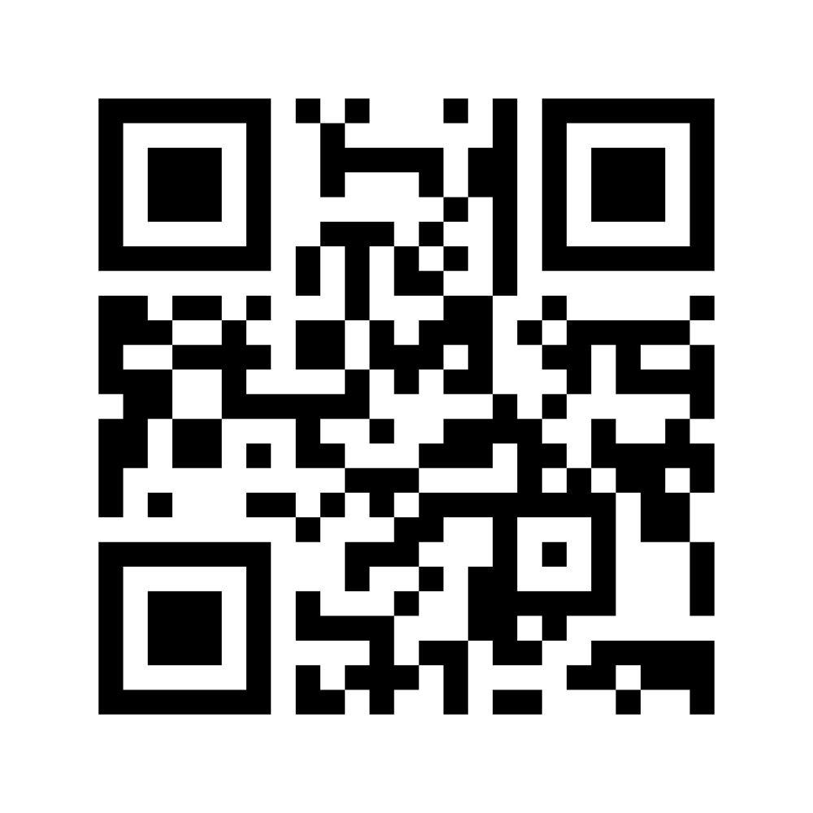
Let’s get to know you!
Results

Slide 3
Timing of Debates
Junior B (Year 8 and below - novice):
4 minutes (warning bell at 3 mins)
Do not speak for more than 4 min 30 sec
Junior A (Year 8 and below - experienced):
5 minutes (warning bell at 4 mins)
Do not speak for more than 5 min 30 sec
Do adjudicators simply ‘stop listening’ after 30 seconds over? No.

Slide 4
How are debates judged?
MATTER | What you say
MANNER | How you say it
METHOD | The order in which you say it / the clarity with which you say it
Adjudicators will score each individual debater on their performance in three areas:

Slide 5
The Criteria
Matter
Arguments – strength, plausibility, relevance, engagement with opposition
Rebuttal
Strength of model
Strength of central premise/case line
Anything pertaining to content
Going under time
Manner
Anything pertaining to the speaker’s presentation style and mannerisms – gesture, tone, pace, etc.
Personal presentation*
Teamwork
Sportsmanship
Conduct
Use of appropriately formal language
Method
Structure – both of an entire speech (inc. summaries etc.) and individual points
Existence of a clear case line and/or model
Splits
Definitions
Greetings
Going over time

Slide 6
PEEL Structure
P – point – state your point (argument - not just a statement of fact)
E – explain or elaborate (explain your argument and why it is valid)
E – evidence or examples (use evidence or examples to support your arguments e.g. NAPLAN when talking about school examinations)
L – link (link back to the topic! Tell the audience why and how your point goes to prove your argument)

Slide 7
School examinations should be banned
Consider what you would say if you were the affirmative – WHY should they be banned? What problem/s do they pose? Why will banning exams solve these problem/s?
Consider what you would say if you were the negative – why SHOULDN’T school exams be banned? Why would this be a bad idea?
Choose ONE reason to discuss with the person next to you and try to use the PEEL structure to present your reason.

Slide 8
Types of Topics
Statements: Homework is a waste of time / privacy is a privilege not a right
Comparisons: The Winter Olympics are more enjoyable than the Summer Olympics
‘Should’ debates: Public transport should be free. In ‘should’ debates, both the moral and practical issues of the topic need to be covered

Slide 9
Definitions
Why do we define the topic?
To provide an accurate dictionary definition of every single word in the topic.
To clarify any potentially unclear terms in the topic and set clear and reasonable parameters for the debate.

Slide 10
Definitions
1st Affirmative: provides a definition for the debate
1st Negative: either accepts that definition OR redefines it
What makes a good definition?
Not a definition of each individual word in the topic straight from the dictionary
you can use a dictionary to help you define technical terms in your topic, but otherwise simply use ‘layman’s terms’ – a simple statement that anybody could come up with and understand
In the intended ‘spirit’ of the debate – what would the average person on the street think this topic is about?
Define terms rather than individual words where appropriate
Negative teams shouldn’t reject for the sake of it – only where they believe it genuinely needs re-defining
Try to avoid ‘definitional debates’: talk of definition shouldn’t progress past second affirmative

Slide 11
Case Line
A summary statement of your overall argument – DO NOT use a cliche
All team arguments must work to prove this
A winning team will have a strong case line that all team members have worked together to prove
The case line should be tied to the speakers’ points
Avoid too much repetition of the case line – saying it at the beginning and end of your speech is enough

Slide 12
To split or not to split?
Using a split:
A split is an OPTIONAL method of organising points between the first and second speaker. Using a traditional split involves:
classifying your arguments into two categories
E.g. society/individuals, social/environmental, social/economic, national/international, long-term/short- term
giving your 1st speaker the ‘bigger picture’ or simply the most significant / relevant side of the split

Slide 13
To split or not to split?
Not using a split:
An alternative option is to simply order your arguments from strongest --> weakest / most important --> least important, then allocate in order to the 1st and 2nd speaker.
This method allows the adjudicator to hear your most important points first, allowing you to open your case strongly.
Strongest argument | 1st speaker
Second-strongest argument
Third-strongest argument | 2nd speaker
Fourth-strongest argument

Slide 14
Changes in 2019/2020 (Manner and Method)
The aim of these changes was to:
Encourage a wider variety of speaking styles
For those styles to be more engaging and entertaining
Encourage whatever manner choices prove comfortable and effective for individual speakers (within reason)
Facilitate a more conversational style of debate, with genuine exchange and engagement between sides, rather than prepared speech style.
Notes:
x

Slide 15
Changes in 2019/2020 (Manner and Method)
To that end:
Students may now use palm cards, A4 paper, or anything in between. However, use must be effective.
They may not read from technological devices.
Students may place a classroom desk (or other available furniture) in front of themselves before their speech if they wish to use such as a lectern.

Slide 16
Changes in 2019/2020 (Manner and Method)
NOTES:
Whilst we are technically open to the use of paper or palm cards across all divisions/year levels, whichever method students choose must come across effectively.
This means that if they use paper ineffectively – if it distracts, constantly rumples in their hand, is covering their face – then you will still penalise under manner.
For the above reason, I would strongly encourage debaters in the Junior B – Intermediate B divisions to stick with palm cards for now. The style of debate we see in those divisions is not such that requires the larger paper to map out ideas. Students in these divisions who do use paper effectively still will not be penalised, but we would suggest that such is unnecessarily difficult for younger students.
Notes:
x

Slide 17
Show Debate

Slide 18
1st Affirmative Speaker

Slide 19
Definitions Note
Topic: Summer is better than winter
We define 'summer' as 'the season between spring and autumn comprising in the southern hemisphere as the months of December, January and February', 'is' as 'to be', 'better' as 'more desirable, satisfactory or effective' , 'than' as 'introducing the second element in a comparison', and 'winter' as 'the season between autumn and spring comprising in the second hemisphere as the months of June, July and August'.
We define ‘summer’ simply as the warmest months of the year and, likewise, ‘winter’ as the coldest months of the year. We don’t believe the precise start and end dates of these seasons are relevant in the spirit of this topic. We also think that the most essential term in tonight’s debate is ‘better than’. What does it mean for one season to be ‘better than’ another? We think it means that, when all pros AND cons are weighed up, one season will have more positive aspects overall.

Slide 20
Affirmative Caseline
Topic: Summer is better than winter
We are arguing that summer is better than winter because summer benefits society far more than winter
Friends, sun, sand and sea - that’s sounds like a summer to me

Slide 21
1st Affirmative
Set the scene for the debate (why are we discussing this topic?) – optional
Define key terms and restate the topic in your own words
Give the case line and state the split
Individual outline – briefly state your points
Give each point/argument with examples – try to have 3 (use PEEL and signpost)
Summary/conclusion (restate your points and your case line)

Slide 22
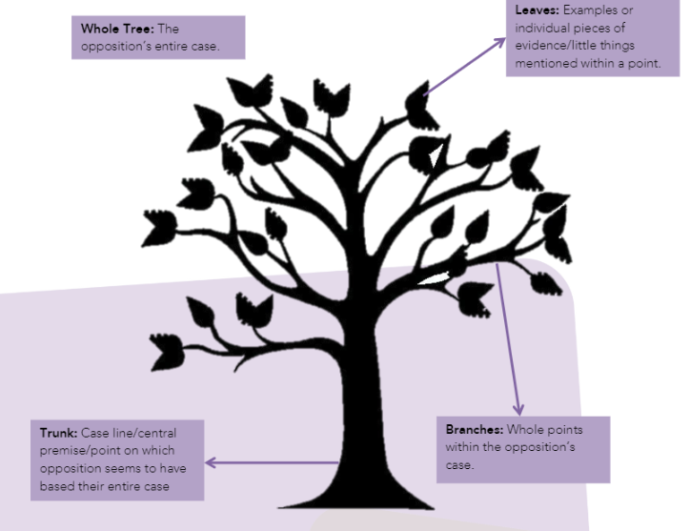
Rebuttal
You must find flaws in the Opposition’s case
It is best to rebut the most important points the Opposition says, especially their central idea/premise (case line) on which their case is based and the points.
DO NOT rebut the examples. Refer to the diagram → attack the trunk and branches, not the leaves

Slide 23
1st Negative Speaker

Slide 24
Formal Greetings
ANY speaker MAY start their speech with a formal greeting if they like.
e.g. “Good evening, everyone.” or “Good evening, Chairperson and audience members.”
We encourage inclusive greetings – speakers are no-longer required to use the precise wording “Good evening, Chairperson, ladies and gentlemen.”
NO speaker is REQUIRED to give a formal greeting.
Note: You should never greet the adjudicator specifically – they are just another member of the audience.

Slide 25
Other Greetings
You might prefer to jump straight into your speech with:
A powerful, relevant quotation
An attention-grabbing fact or statement
A summary of the debate so far (also known as a ‘case comparison’) that presents your team’s case as superior

Slide 26
Negative Caseline
Topic: Summer is better than winter
We are arguing that summer is not better than winter because there are dangers to society in summer that simply don't exist in winter
We believe that summer is THE WORST time of year – it’s an ABSOLUTELY INSUFFERABLE, suffocating, horrific, cancer-causing experience that no one could possibly survive, let alone enjoy.

Slide 27
1st Negative
Accept (or redefine) the definition
Give your case line
Rebuttal (try to rebut at least one of the 1st Affirmative’s points)
Team outline (including the split if you have one)
Give each point/argument with examples – try to have 3 (use PEEL and signpost)
Summary/conclusion (restate your points and your case line)

Slide 28
Signposting
Signposting helps the adjudicator, the audience, and the opposing team to follow your argument. It is a very simple tool that helps carry the debate, and makes your case stronger and more logical. How to signpost:
In introduction: “Tonight I have three points. These are….”
In your arguments: “My first point is….” “My next argument is that….” “Finally, we would argue that….”
In conclusion: “Ladies and gentlemen, tonight I present three points. They were … (1, 2, and 3). All these points clearly prove that (caseline)…

Slide 29
2nd Affirmative Speaker

Slide 30
2nd Affirmative and Negative
Rebuttal – try to have at least one, go for as many as you can
Restate the points your 1st Speaker had and their split (if you have one)
Give your side of the split and how many points you have
Individual outline – briefly state your points
Give each point/argument with examples – try to have 3 (use PEEL and signpost)
Summary/conclusion (restate your points and your case line)

Slide 31
Rebuttal – Student activity
Structure of a rebuttal:
Say what was said
Explain what was wrong/misleading
Say what is right and give an example (prove your case is better)
Say how this proves your side of the topic
Can you rebut a rebuttal? YES, if you think it will strengthen your case

Slide 32
2nd Negative Speaker

Slide 33
2nd Affirmative and Negative
Rebuttal – try to have at least one, go for as many as you can
Restate the points your 1st Speaker had and their split (if you have one)
Give your side of the split and how many points you have
Individual outline – briefly state your points
Give each point/argument with examples – try to have 3 (use PEEL and signpost)
Summary/conclusion (restate your points and your case line)

Slide 34
3rd Affirmative Speaker

Slide 35
3rd Affirmative and Negative
Outline where the debate is at. E.g. “The Opposition has tried to prove that…. Whereas we have argued strongly that..”
Rebuttal (of both 1st and 2nd speakers – in the order of importance). For each argument state:
What they said
Why they are wrong
What is right/Why your team is right
Case Summary of your 1st and 2nd Speakers’ points
Concluding statement: make it persuasive and strong as you finish your team’s

Slide 36
3rd Negative Speaker

Slide 37
3rd Affirmative and Negative
Outline where the debate is at. E.g. “The Opposition has tried to prove that…. Whereas we have argued strongly that..”
Rebuttal (of both 1st and 2nd speakers – in the order of importance). For each argument state:
What they said
Why they are wrong
What is right/Why your team is right
Case Summary of your 1st and 2nd Speakers’ points
Concluding statement: make it persuasive and strong as you finish your team’s

Slide 38
The Short Prep Debate
Arrive at the venue early
You will be given the topic and time to prepare
1 h 45 mins for Junior B and Junior A
1 h 30 mins for Inter B and Inter A
1 hour for Open B and Open A
Teams of four prepare in a classroom from start to finish
Resources are strictly limited (dictionary/thesaurus, book of quotes, paper and pens)
No technology allowed (including phones and smart watches) PENALTIES/DISQUALIFICATION
Debate begins at the usual starting time (6pm)

Slide 39
Kahoot!

Slide 40
GOOD LUCK FOR 2022!
@goldcoastdebating
@goldcoastdebating
Goldcoastdebating.org
If you are in year 11 or 12 – stay here for junior adjudication
For more information visit goldcoastdebating.org

